Slide 1
Loan Repayment & Credit Risk Analysis
Power BI Dashboard Project
Fintech / Banking Domain
Prepared by: Abhinav Shivhare
Tool Used: Power BI

Slide 2
Introduction
In the banking and fintech industry, understanding loan repayment behavior and credit risk is crucial to maintaining a healthy loan portfolio.
This Power BI project focuses on analyzing loan repayment patterns, borrower profiles, and delinquency behavior to identify risk factors associated with loan defaults.
The dashboard provides data-driven insights that help financial institutions improve credit decision-making, reduce default risk, and optimize loan performance.

Slide 3
Objectives
To analyze loan repayment and default behavior of borrowers.
To identify high-risk borrowers using credit score, delinquencies, and repayment status.
To compare loan performance across employment status, education level, and loan purpose.
To analyze loan trends over time using year, quarter, and monthly analysis.
To calculate key credit risk KPIs such as Repayment Rate, Default Rate, and Outstanding Amount.

Slide 4
Business Requirement Document (BRD)
Business Requirement
Expected Business Outcomes
Understand loan repayment behavior and credit risk to reduce defaults
Identify high-risk borrowers using credit score and delinquency data
Enable time-based analysis to track loan performance
Display key KPIs for quick decision-making
Better visibility into loan portfolio health
Early identification of default-prone borrowers
Improved credit risk assessment
Support for data-driven lending decisions

Slide 5
Dataset Overview
The dataset contains 20,000+ loan records, representing borrower and loan-level information from the banking and fintech domain.
The data covers a time period from 2021 to 2023, which allows trend and time-based analysis.
Each record represents an individual loan along with borrower characteristics and repayment status.
The dataset includes both numerical and categorical variables, enabling comparative, compositional, and statistical analysis.

Slide 6
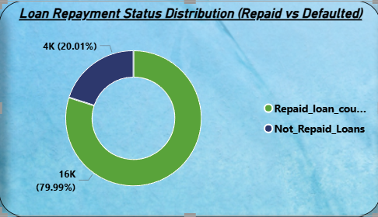
Loan Repayment Status Distribution
This chart shows the overall loan repayment performance.
Around 80% of loans are successfully repaid, while nearly 20% fall under default category.
This gives a quick snapshot of portfolio health.

Slide 7
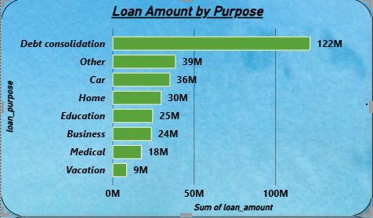
Loan Amount by Purpose
This chart compares total loan amount across different loan purposes.
Debt consolidation contributes the highest loan amount, followed by car and home loans.
This helps identify major drivers of loan demand.

Slide 8
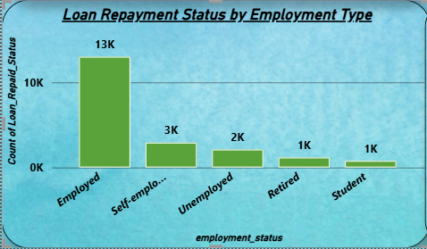
Loan Repayment Status by Employment Type
This chart analyzes loan repayment behavior across employment categories.
Employed borrowers have the highest repayment count, indicating more stable income sources.
Unemployed and student segments show relatively lower repayment volumes.

Slide 9
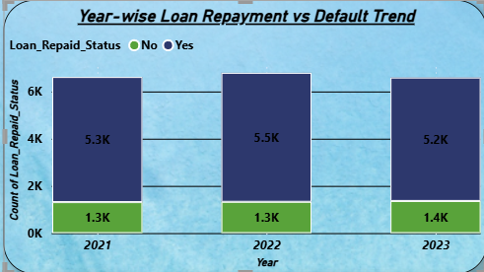
Year-wise Loan Repayment vs Default
This chart shows year-wise comparison of repaid and defaulted loans.
Loan volumes peaked in 2022, while default levels remained relatively consistent.
This indicates stable risk performance over time.

Slide 10
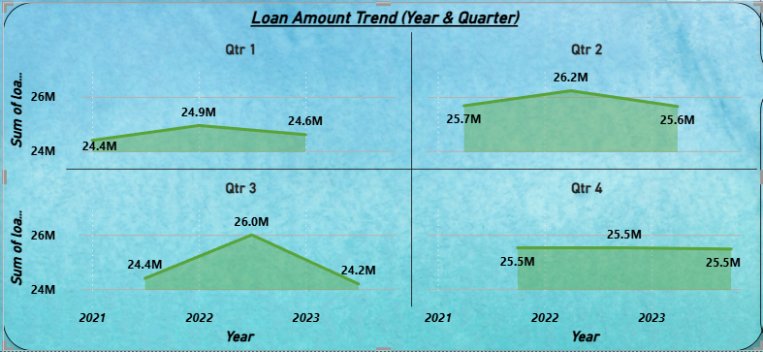
Loan Amount Trend (Year / Quarter)
This chart tracks loan amount trends across years and quarters.
Loan disbursement increased in 2022 and slightly stabilized in 2023.
Time-based analysis helps in understanding growth and seasonality.

Slide 11
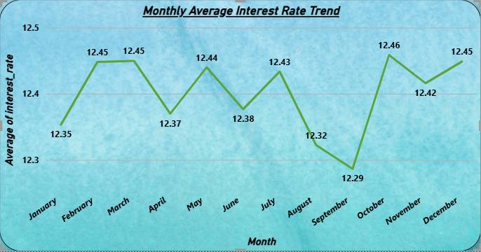
Monthly Average Interest Rate Trend
This chart shows monthly fluctuations in average interest rates.
Interest rates remain mostly stable with minor seasonal variations.
This helps assess pricing consistency over time.

Slide 12
Key Insights
The overall loan repayment rate is around 80%, which indicates a generally healthy loan portfolio. However, the remaining default portion still represents a significant risk exposure.
Debt consolidation loans contribute the highest share of total loan amount, making them the most influential loan category in the portfolio.
Employed borrowers show better repayment behavior compared to unemployed or student segments, highlighting the importance of income stability in loan performance.
Loan disbursement and repayment activity peaked in 2022, while default levels remained relatively stable across years.
Higher delinquency levels are associated with higher outstanding loan balances, increasing overall credit risk for the institution.

Slide 13
Recommendations
Financial institutions should closely monitor borrowers with past delinquencies, as they carry higher default risk and outstanding exposure.
Stricter credit checks and risk-based pricing should be applied for high-risk borrower segments to reduce future defaults.
Since debt consolidation loans dominate the portfolio, lenders should review eligibility criteria and repayment terms for this category.
Early warning systems should be implemented to identify repayment issues at an early stage and take preventive action.
Banks and NBFCs can use these insights to optimize lending strategies and improve overall portfolio quality.

Slide 14
Conclusion
This Power BI project successfully analyzes loan repayment behavior and credit risk using real-world fintech metrics.
The dashboard provides a clear understanding of repayment trends, borrower risk profiles, and delinquency patterns.
Key KPIs such as repayment rate, default rate, and outstanding amount help in data-driven credit decision-making.
Overall, the project demonstrates practical skills in data analysis, business understanding, and Power BI visualization.
This project demonstrates how data visualization can support effective credit risk management.

